Slide 1


By Catherine Olwal
UtuBot: Empowering African Youth Through Accessible SRHR Information
Revolutionizing sexual and reproductive health rights education for young people across Africa.

Slide 2





The Challenge: A Critical Gap in SRHR Access
Widespread Misinformation
Stigma & Shame
Limited Access
Lack of reliable, age-appropriate information leads to dangerous myths and misconceptions about sexual health.
Cultural conservatism often creates barriers, making open discussions about SRHR difficult and shameful.
Many adolescents, especially in rural or under-resourced areas, lack access to clinics and health educators.

Slide 3
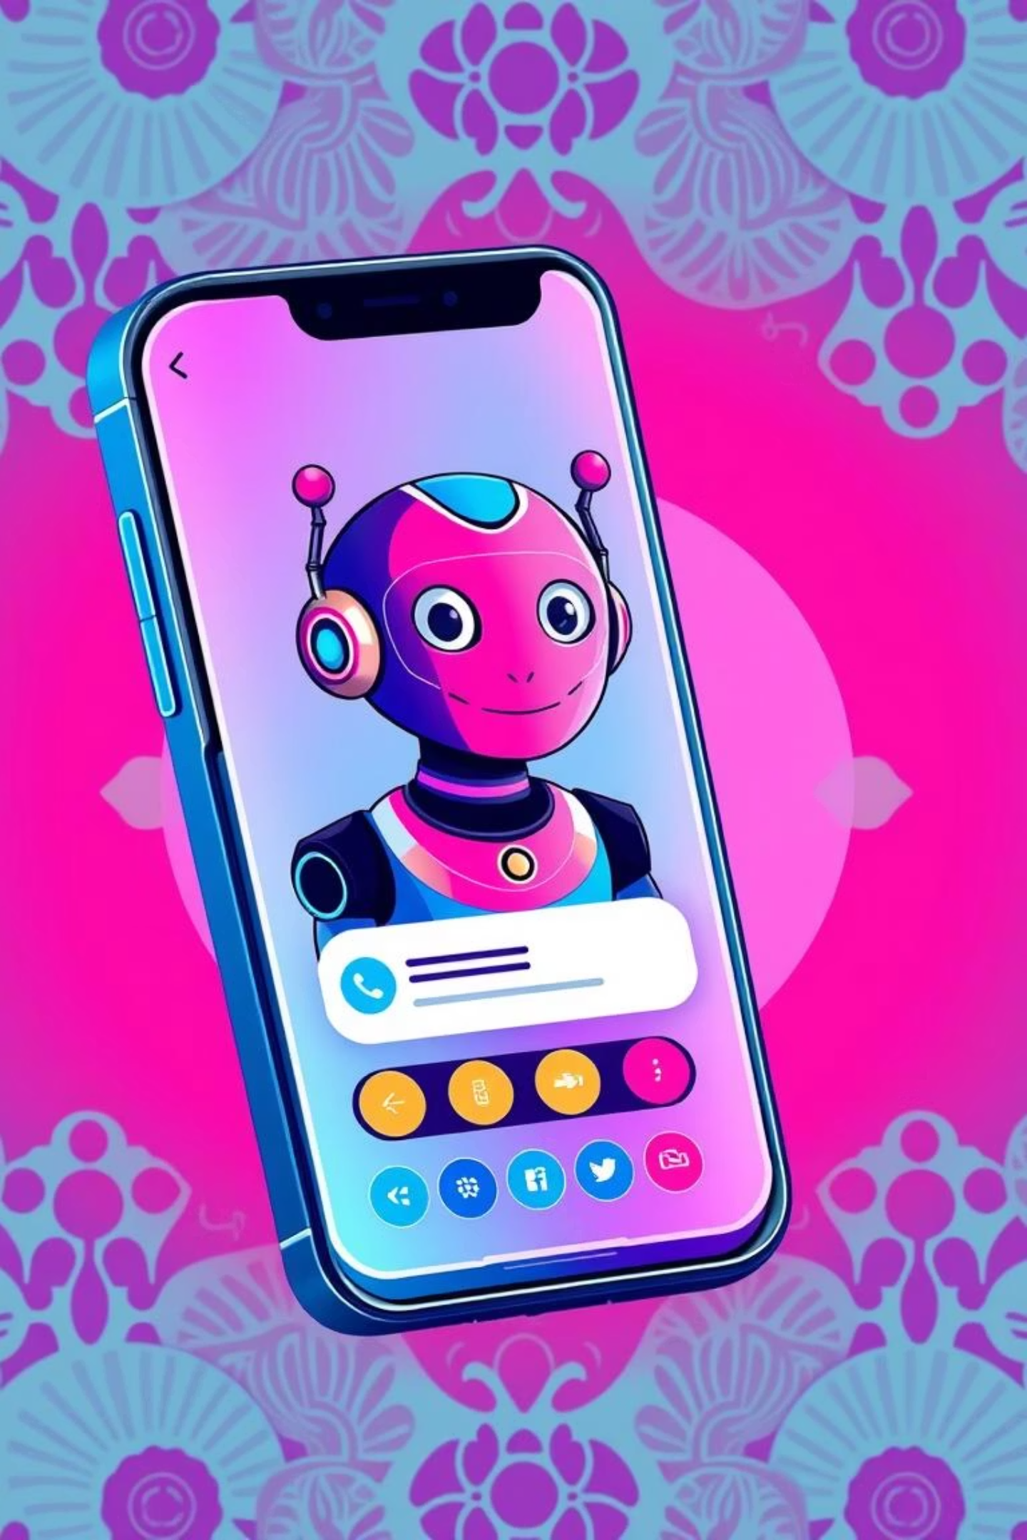
Introducing UtuBot: Your Trusted SRH Companion
UtuBot is an AI-powered chatbot designed to provide accurate, accessible and culturally appropriate sexual and reproductive health information to African adolescents and youth.

Slide 4



How UtuBot Works: Simple, Safe, Shame-Free
Mobile-First Access
Confidential Q&A
Accurate Information
Works seamlessly on any mobile device via a simple chat interface.
Users ask questions; UtuBot provides instant, age appropriate answers.
Covers consent, contraception, STIs, puberty, relationships and more.

Slide 5
Impact & Benefits: Fostering Healthier Futures
Empowered Decisions
Reduced Stigma
Improved Well-being
Equips youths with knowledge to make informed choices about their bodies and lives.
Provides a safe, non-judgmental space for sensitive questions, breaking down societal taboos.
Contributes to better SRH outcomes, leading to healthier and more fulfilling lives.

Slide 6

Technology Stack: Powering Intelligent Conversations
AI Core
Development Framework
Leverages cutting-edge OpenAI Large Language Models for natural and accurate responses.
Robust and scalable architecture for seamless performance.
Frontend: Streamlit for user-friendly interface
GPT-3.5/GPT-4 for conversational intelligence
Backend: Flask for API and data handling
Fine-tuning for cultural nuances

Slide 7


Aligning with Global Goals
UN SDG 3: Good Health & Well-being
UN SDG 5: Gender Equality
By promoting comprehensive SRH education, UtuBot directly contributes to healthier lives and reduced preventable deaths among adolescents and youths.
Empowering young women and men with SRH knowledge fosters gender equality and reproductive autonomy.

Slide 8


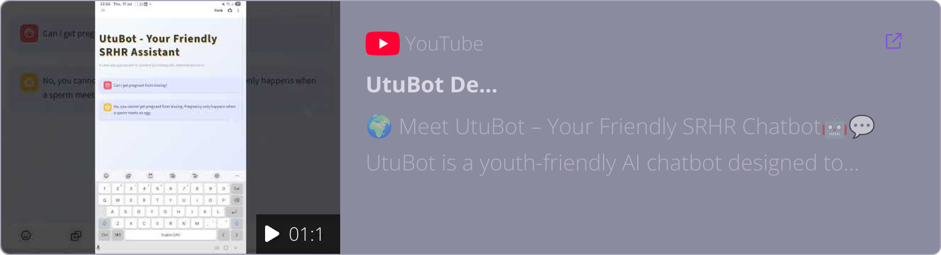


UtuBot in Action: A Guided Demo
See UtuBot in action: a live demonstration of its intuitive interface and power to deliver critical SRHR information.
Interactive Conversations
Experience UtuBot's immediate, context-aware responses to SRHR questions.
Intuitive Design
Navigate the user-friendly chat interface, designed for seamless youth interaction.
Privacy & Trust
See how UtuBot provides a safe, confidential space for sensitive health queries.

Slide 9
Roadmap & Future Features
Phase 3: Community & AI Enhancement
Phase 2: Expanded Content & Resources
Phase 1: Pilot & Localisation
Develop peer-to-peer support features and continuously refine AI model for improved accuracy and empathy.
Launch pilot programmes in select regions, gather feedback and incorporate local dialects and cultural nuances.
Integrate multimedia content (videos, infographics) and provide links to local SRH service providers.

Slide 10



Invest in a Healthier, Empowered Future
UtuBot is an investment in the health, well-being and future of African youth. Together, we can break down barriers and build a more informed generation.
THANK YOU!

